Slide 1
MM 225 – AI and Data Science Day 5: Random Variable : Discrete Special cases
Instructors: Hina Gokhale, MP Gururajan, N. Vishwanathan
1 August 2024

Slide 2

Review – CDF and PMF
For the following cdf given for RV X, Find probability mass function
$F\left(x\right)= \left\{\begin{aligned}0 for x<−1 \\ 0.1 for −1 ≤x<1 \\ 0.3 for 1 ≤x<6 \\ 0.5 for 6≤x<10 \\ 1 for 10 ≤x\end{aligned}\right.$

Slide 3
Special cases of Discrete Random Variable
Bernoulli Trials and Bernoulli Distribution
Binomial Distribution
Poisson Distribution
Hypergeometric Distribution

Slide 4
Bernoulli Trials:
The case of only two possible outcomes :
Success or Failure
Defective or non-defective
Yes or No
S = {Success, Failure}

Slide 5
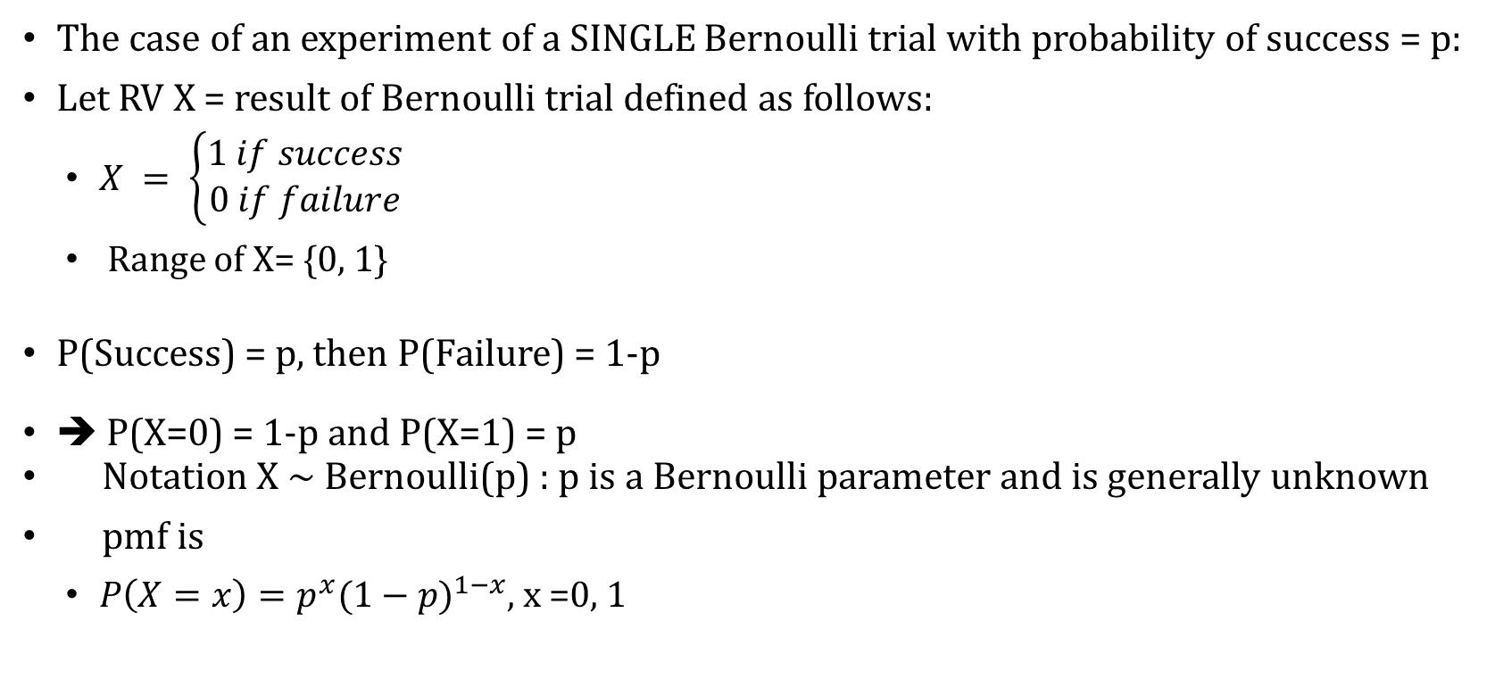
Bernoulli Distribution
The case of an experiment of a SINGLE Bernoulli trial with probability of success = p:
Let RV X = result of Bernoulli trial defined as follows:
$X = \left\{\begin{aligned}1 if success \\ 0 if failure\end{aligned}\right.$
Range of X= {0, 1}
P(Success) = p, then P(Failure) = 1-p
➔ P(X=0) = 1-p and P(X=1) = p
Notation X ~ Bernoulli(p) : p is a Bernoulli parameter and is generally unknown
pmf is
$P\left(X=x\right)=p^{x}{(1−p)}^{1−x}$, x =0, 1

Slide 6
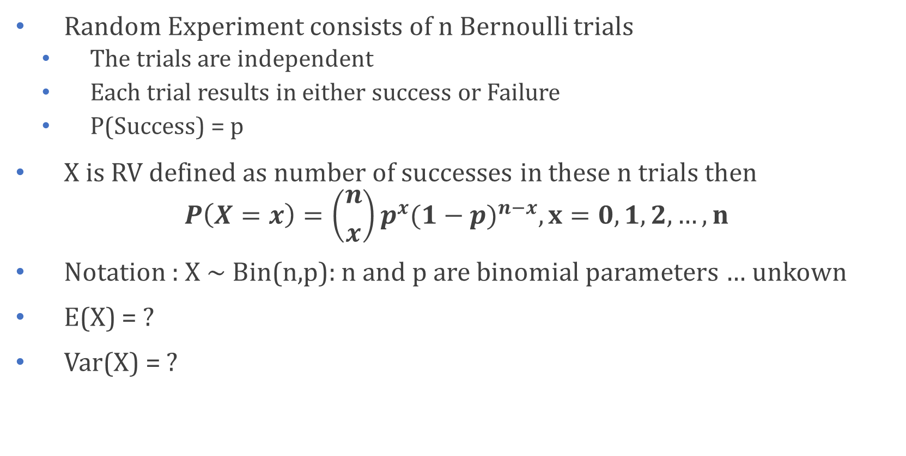
Binomial Distribution
Random Experiment consists of n Bernoulli trials
The trials are independent
Each trial results in either success or Failure
P(Success) = p
X is RV defined as number of successes in these n trials then
$$P\left(X=x\right)=\left({n \atop x}\right)p^{x}{(1−p)}^{n−x}, x=0,1, 2, …, n$$
Notation : X ~ Bin(n,p): n and p are binomial parameters … unkown
E(X) = ?
Var(X) = ?

Slide 7
Example: Binomial Distribution
According to Chemical Engineering Progress (November 1990), approximately 30% of all pipework failures in chemical plants are caused by operator error. What is the probability that out of the next 20 pipework failures at least 10 are due to operator error?
Solution:
Let X be failures due to operator error: X ~ Bin(20, 0.3)
Need to find P(X ≥ 10) = 1-P(X≤9)

Slide 8
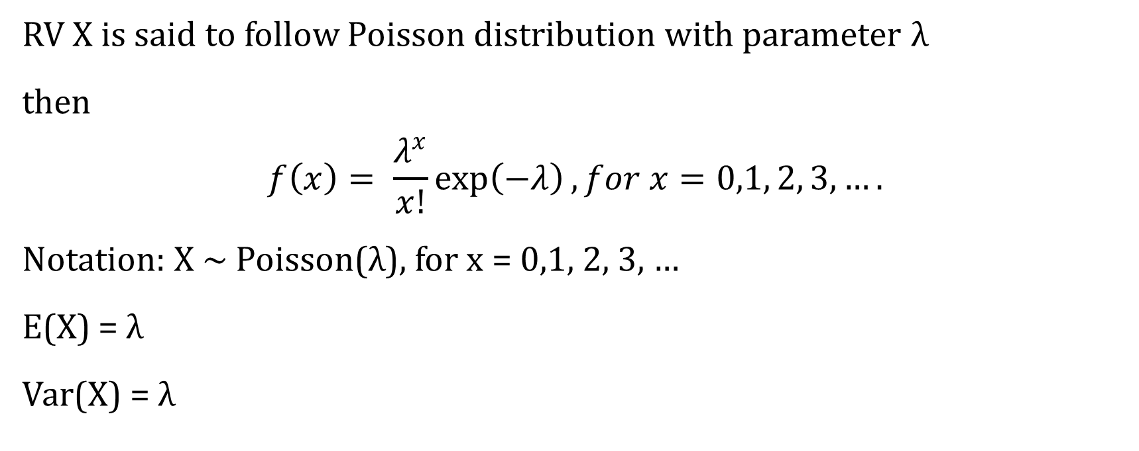
Poisson Distribution
RV X is said to follow Poisson distribution with parameter λ
then
$$f\left(x\right)= \frac{λ^{x}}{x!}\exp\left(−λ\right), for x=0,1, 2, 3, ….$$
Notation: X ~ Poisson(λ), for x = 0,1, 2, 3, …
E(X) = λ
Var(X) = λ

Slide 9
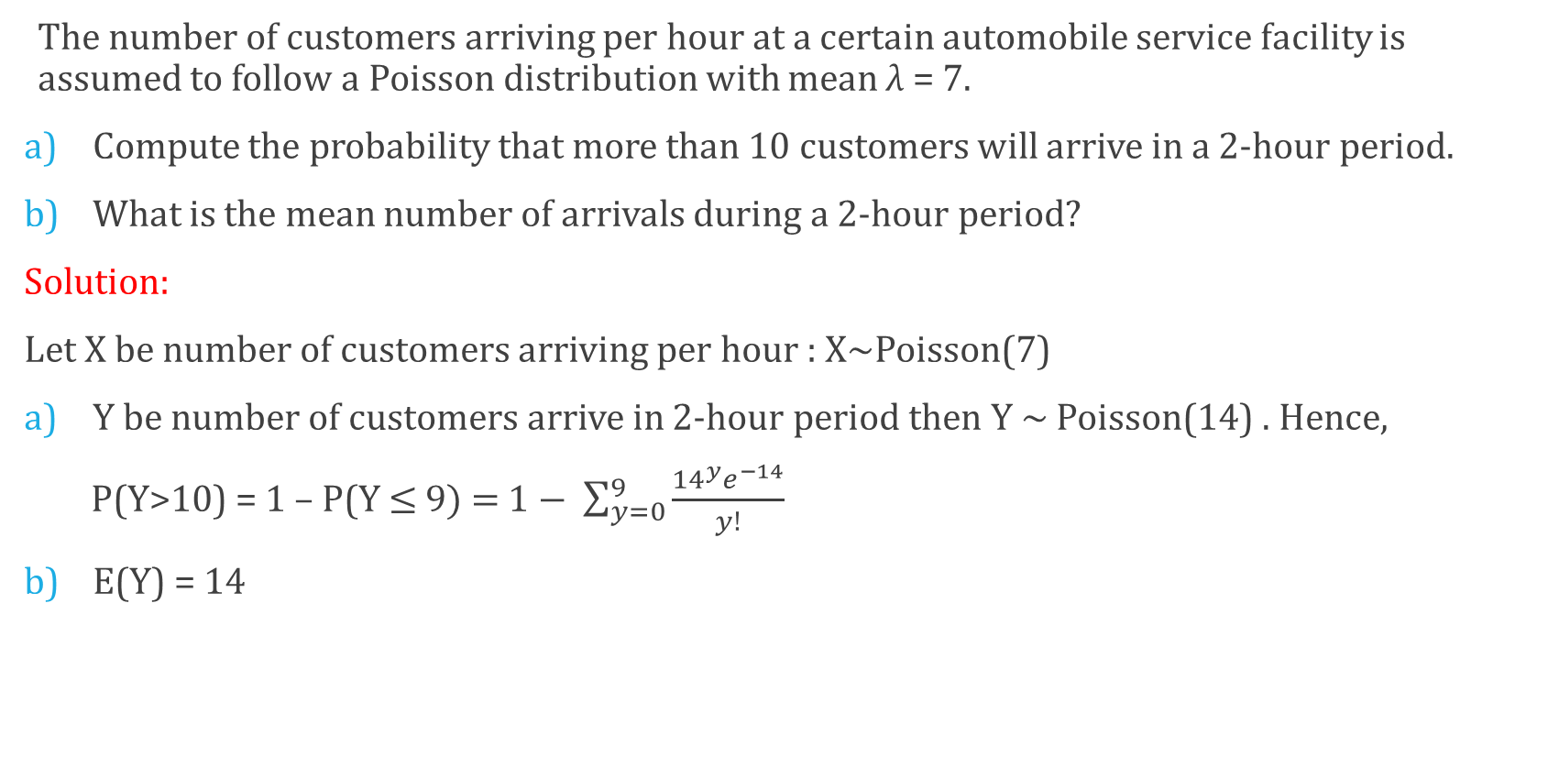
Poisson Distribution: Example
The number of customers arriving per hour at a certain automobile service facility is assumed to follow a Poisson distribution with mean λ = 7.
Compute the probability that more than 10 customers will arrive in a 2-hour period.
What is the mean number of arrivals during a 2-hour period?
Solution:
Let X be number of customers arriving per hour : X~Poisson(7)
Y be number of customers arrive in 2-hour period then Y ~ Poisson(14) . Hence,
P(Y>10) = 1 – P(Y ≤ 9) = $1− \sum_{y=0}^{9}{\frac{{14}^{y}e^{−14}}{y!}}$
E(Y) = 14

Slide 10
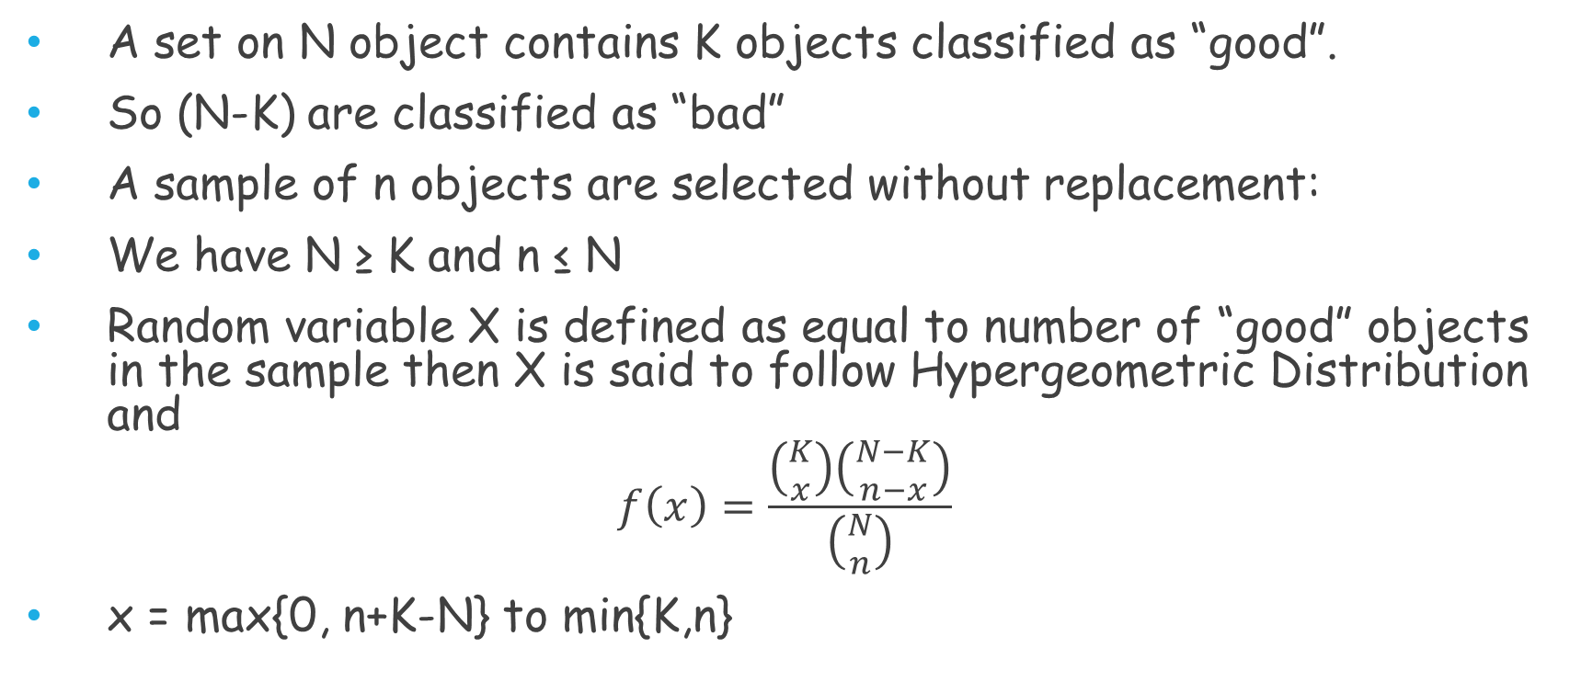
Hypergeometric Distribution
A set on N object contains K objects classified as “good”.
So (N-K) are classified as “bad”
A sample of n objects are selected without replacement:
We have N ≥ K and n ≤ N
Random variable X is defined as equal to number of “good” objects in the sample then X is said to follow Hypergeometric Distribution and
$$f\left(x\right)=\frac{\left({K \atop x}\right)\left({N−K \atop n−x}\right)}{\left({N \atop n}\right)}$$
x = max{0, n+K-N} to min{K,n}

Slide 11
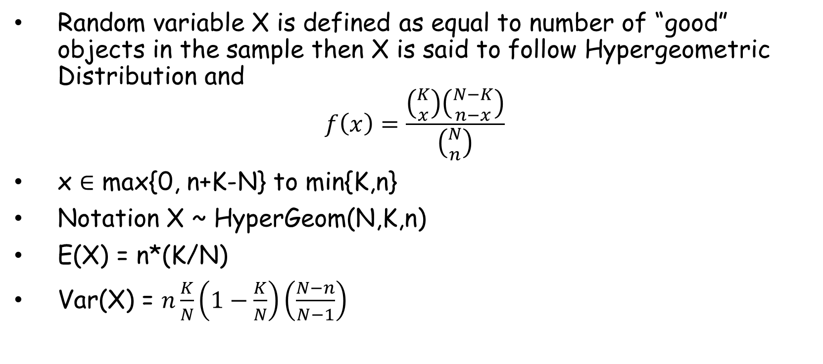
Hypergeometric Distribution
Random variable X is defined as equal to number of “good” objects in the sample then X is said to follow Hypergeometric Distribution and
$$f\left(x\right)=\frac{\left({K \atop x}\right)\left({N−K \atop n−x}\right)}{\left({N \atop n}\right)}$$
x ∈ max{0, n+K-N} to min{K,n}
Notation X ~ HyperGeom(N,K,n)
E(X) = n*(K/N)
Var(X) = $n\frac{K}{N}\left(1−\frac{K}{N}\right)\left(\frac{N−n}{N−1}\right)$

Slide 12
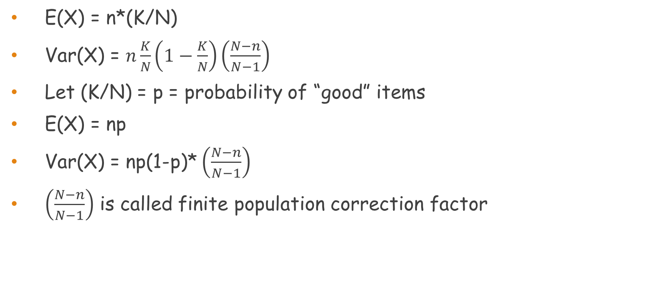
Hypergeometric Distribution
E(X) = n*(K/N)
Var(X) = $n\frac{K}{N}\left(1−\frac{K}{N}\right)\left(\frac{N−n}{N−1}\right)$
Let (K/N) = p = probability of “good” items
E(X) = np
Var(X) = np(1-p)* $\left(\frac{N−n}{N−1}\right)$
$\left(\frac{N−n}{N−1}\right)$ is called finite population correction factor

Slide 13
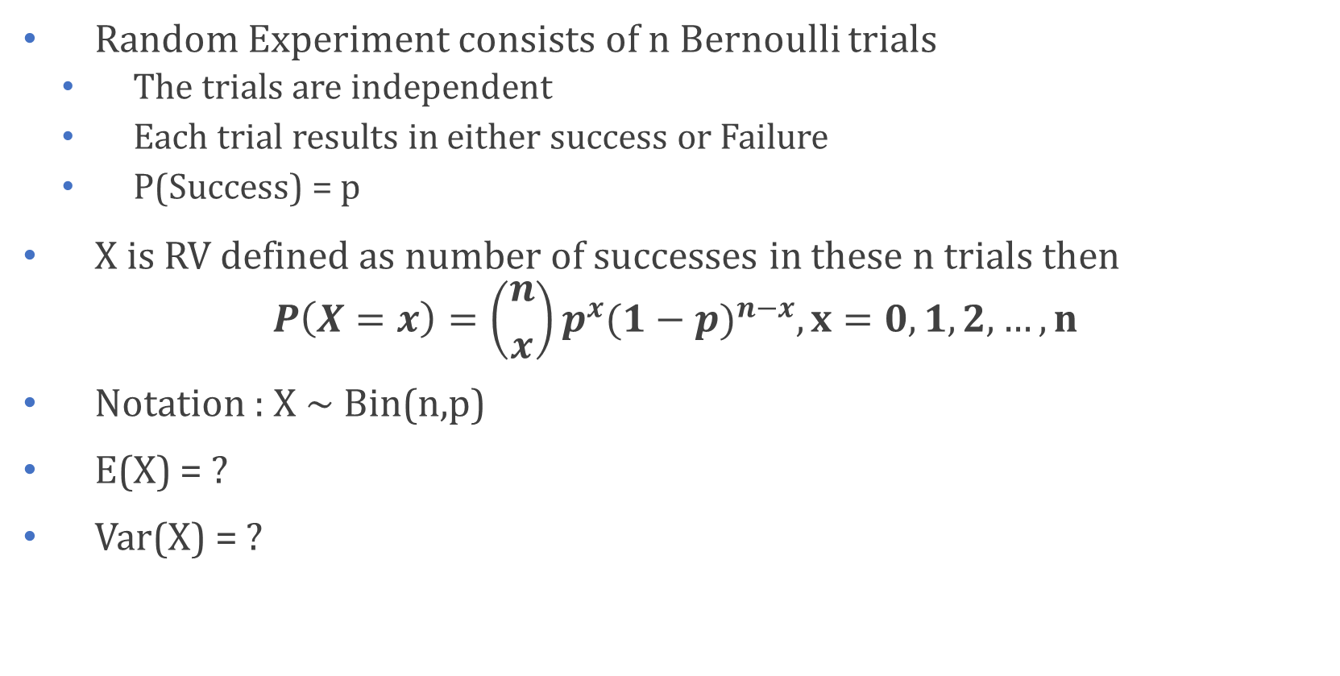
In Class Problem…
Random Experiment consists of n Bernoulli trials
The trials are independent
Each trial results in either success or Failure
P(Success) = p
X is RV defined as number of successes in these n trials then
$$P\left(X=x\right)=\left({n \atop x}\right)p^{x}{(1−p)}^{n−x}, x=0,1, 2, …, n$$
Notation : X ~ Bin(n,p)
E(X) = ?
Var(X) = ?

